Slide 1
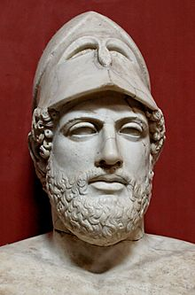
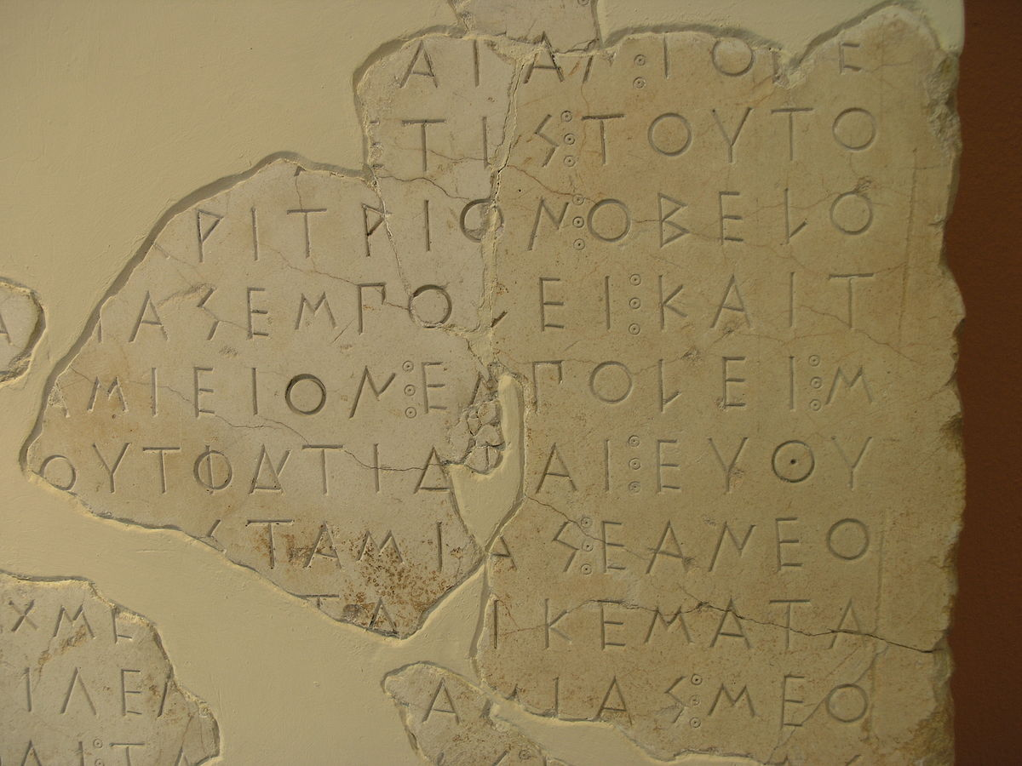
Re-dating the Athenian Empire
DR GIL DAVIS
gil.davis@mq.edu.au
Option H Greece: The Greek World 500 – 400 BC Development of
2 Athens and the Athenian Empire
Option G Pericles Evaluation
4

Slide 2
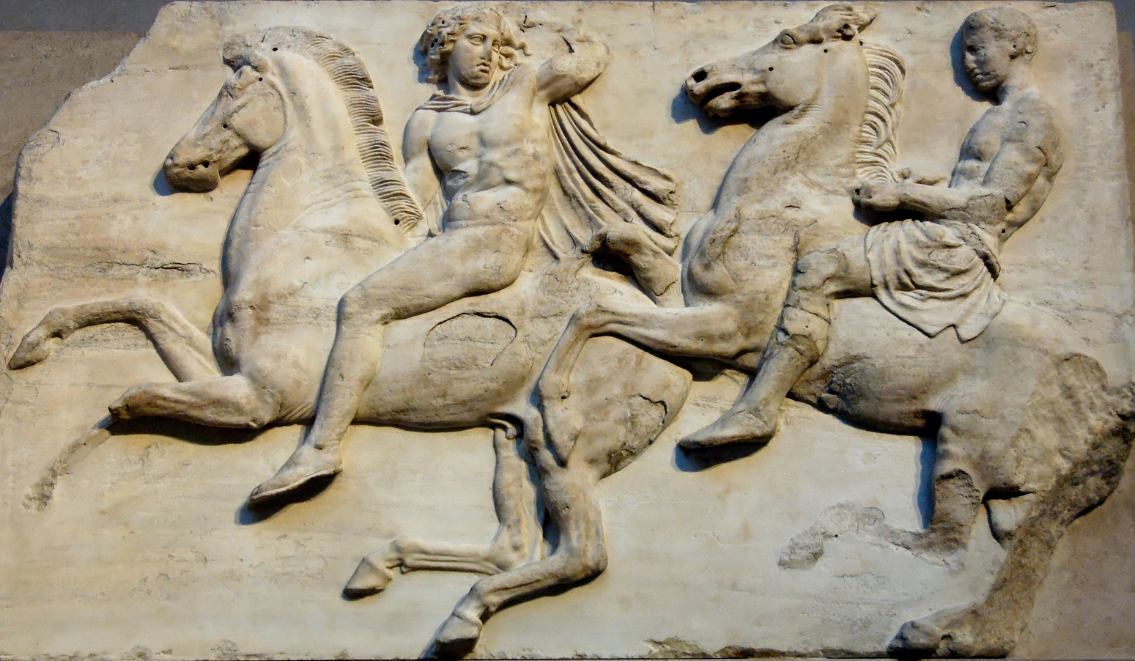
What I will discuss
The nature of the problem & why it is important
The history of the 3-bar sigma debate – the “sigma-enigma”*
New dating criteria
Old & new dates
2 case studies
Dating imperialism
* A. Henry, ZPE 120 (1998) 45-8
Cavalcade. Block II from the west frieze of the Parthenon, ca. 447–433 B.C.
Department of Ancient History

Slide 3
The nature of the problem & why it is important
* Our understanding of the Athenian Empire is based upon three types of evidence:
Texts, including Thucydides, Plutarch, Xenophon, Diodorus Siculus, plays etc
Archaeology, including artefacts such as coins
Inscriptions
* There has been a tendency to privilege the first type of evidence, especially Thucydides,
with absence of evidence often being seen as significant
* Epigraphical evidence from inscriptions can pose interpretive difficulties due to missing
or damaged sections, especially dates which rely mainly on the name of the eponymous
Archon being preserved. In the absence of this, epigraphists have relied upon other criteria
Department of Ancient History

Slide 4
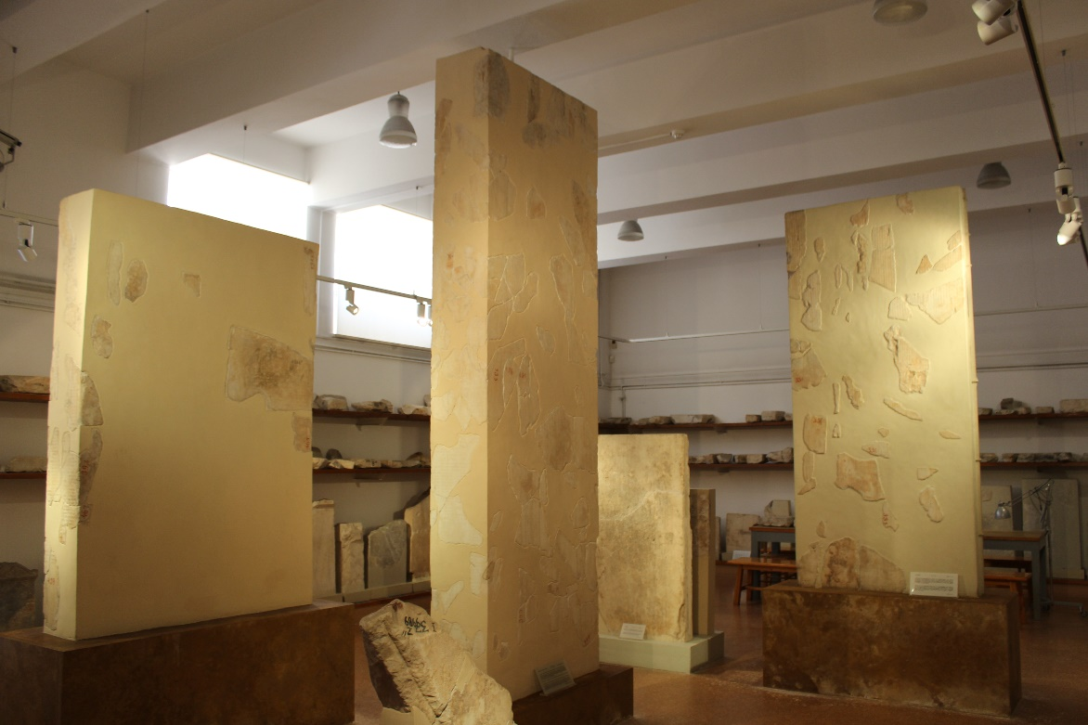
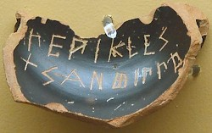
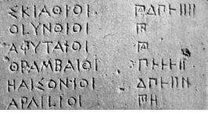
The history of the 3-bar sigma debate
ATL published in 1939
Used the 3-bar sigma lettering criterion which held that no Athenian public document containing this form (as opposed to the Ionic 4-bar sigma) could predate the year 446 B.C. (= date of last aparchē inscription – IG I³ 265)
Cf use of ‘tailed rho’
From 1961, Harold Mattingly alone opposed
In 1990, Chambers, Gallaci & Spanos used photo-enhancement & laser scanning to argue that the archon on the Egesta decree was [Ant]iphon (418/7 B.C.), not [Ha]bron (dated 458/7 B.C.).
It took until 2010 for this to be widely accepted
Athenian tribute lists in the Athens Epigraphical Museum. It is worth
remembering how much is restored, and missing! Cf. Stroud 2006
Department of Ancient History

Slide 5
New dating criteria
Historical contextualisation should always take precedence over other considerations.
Grammatical observations can be good guidelines: similarity in diction, syntax, idioms and similia offer good comparison anchors.
Archon names appear in the prescripts of Attic decrees from 421/0 onwards. Clearly something caused the Athenians to reorganise their bureaucratic protocol (perhaps the Peace of Nicias).
(Papazarkadas 2009, 68)
But, not every 5th-century inscription must be down-dated; it only means that the later date cannot be ruled out on account of its letter forms.
(Rhodes 2008, 503)
Department of Ancient History

Slide 6
Key decrees – old orthodox dating
M&L | IG I³ | M&L date | Subject | Context
31 | 10 | 469-50 | Phaselis | Compelling court cases to be held at Athens
37 | 11. a | 458/7 ? | (S)Egesta | Involvement in Sicily
40 | 14 | c. 453/2 | Erythrae | Allied submission - requirement for members of the League to bring offerings to Great Panathenaia
44 | 35 | c. 448 | Athena Nike | Acropolis building program
45 | 1453 + ors | 450-46 | Coinage etc | Enforcing the use of Athenian coins, weights and measures
46 | 34 | 447 ? | Tribute (Clinias) | Tightening up tribute collection – allies as cash cows
47 | 37 | 447/6 ? | Colophon | Treaty imposing democracy
52 | 40 | 446/5 | Chalcis | Oath of loyalty to Athens
Department of Ancient History

Slide 7
Key decrees – new dating
M&L | IG I³ | M&L date | New date | Subject/Context
40 | 14 | c. 453/2 | 435/4 | Erythrae: Allied submission - requirement for members of the League to bring offerings to Great Panathenaia
47 | 37 | 447/6 ? | 428/7 | Colophon: Treaty imposing democracy
31 | 10 | 469-50 | 420s | Phaselis: Compelling court cases to be held at Athens
46 | 34 | 447 ? | 425/4 | Clinias: Tightening up tribute payment
45 | 1453 + ors | 450-46 | 425 | Coinage: Enforcing the use of Athenian coins, weights and measures
52 | 40 | 446/5 | 424/3 | Chalcis: Oath of loyalty to Athens
44 | 35 | c. 448 | 424/3 | Athena Nike: Acropolis building program
37 | 11. a | 458/7 ? | 418/7 | (S)Egesta: Involvement in Sicily
Department of Ancient History

Slide 8
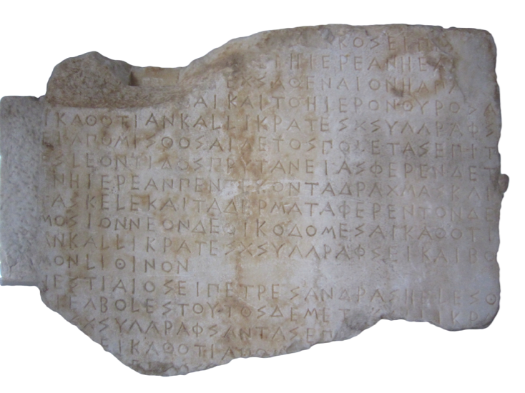
Case studies
IG I³ 35 – Athena Nike decree
[ἔδοχσεν τeι βολeι καὶ τo]ι [δέ]μ̣ο̣[ι·…] 1 [……ἐπεστάτει..8].ι̣κος εἶπε· [τeι] [Ἀθεναίαι τeι Νί]κ̣ει hιέρεαν hὲ ἄγ̣[..] […..11…..]ι ἐχς Ἀθεναίον hαπα[σο] [ν…7….].σ̣θ̣αι καὶ το hιερὸν θυρoσα- 5 ι καθ’ ὅ τι ἂν Καλλικράτες χσυγγράφσ- ει· ἀπομισθoσαι δὲ τὸς πολετὰς ἐπὶ τ- eς Λεοντίδος πρυτανείας· φέρεν δὲ τ- ὲν hιέρεαν πεντέκοντα δραχμὰς καὶ τὰ σκέλε καὶ τὰ δέρματα φέρεν τoν δε- 10 μοσίον· νεὸν δὲ οἰκοδομeσαι καθότι ἂν Καλλικράτες χσυγγράφσει καὶ βο- μὸν λίθινον. vac. hεστιαῖος εἶπε· τρeς ἄνδρας hελέσθ- αι ἐγ βολeς· τούτος δὲ μετ[ὰ] Καλλικρά- 15 [το]ς χσυγγράφσαντας ἐπ[….10……] [..4..]ει καθ’ ὅ τι ἀπομ̣[ισθοθέσεται..] […6…] ε̣ι [.] ος […..18……..]
c. 448 or 424/3 B.C. ?
Department of Ancient History

Slide 9
Case studies
IG I³ 35 – Athena Nike decree
[…].ikos proposed: to select (or: establish) as a priestess for Athena Nike whoever will be [allotted] from all Athenian women and to provide the sanctuary with doors in whatever way Kallikrates will specify; and the poletai are to place the contract within the prytany of Leontis; the priestess is to receive fifty drachmai and to receive the backlegs and hides of the dêmosios sacrifices; and that a temple be built in whatever way Kallikrates may specify and a stone (marble) altar. vac.
Hestiaios proposed: that three men be selected from the boulê; and that they will make the specifications with Kallikrates and […..] in accordance with [the contracts…]
The polis decided to honour Athena with new sacrifices
Paid by the dēmos to garner her support or thank her for victory
Radical step of creating a new priestess selected from all Athenians (not a genē)
Glorious new temple and altar
Priestess appointed for life and renumerated by perquisites + 50 drachmae. p.a.
Department of Ancient History

Slide 10
Case studies
IG I³ 35 – Athena Nike decree
Post quem is 448 when the Acropolis building program was conceived. The embellishment of the cult of Athena Nike and the construction of her temple are part of this.
Ante quem is IG I³ 36 which refers explicitly to the earlier decision conventionally dated to 424/3.
The temple was built in the 420s and Mattingly suggested the decrees should be associated with this.
BUT:
The decree could have been associated with the commissioning of the building works in 448.
The plan of the temple required integration with the SW wing of the Propylaea begun in 437; there was a large treasury of Nike in her sanctuary before 433/2 which could have required doors.
So there are several plausible historical contexts
Department of Ancient History

Slide 11
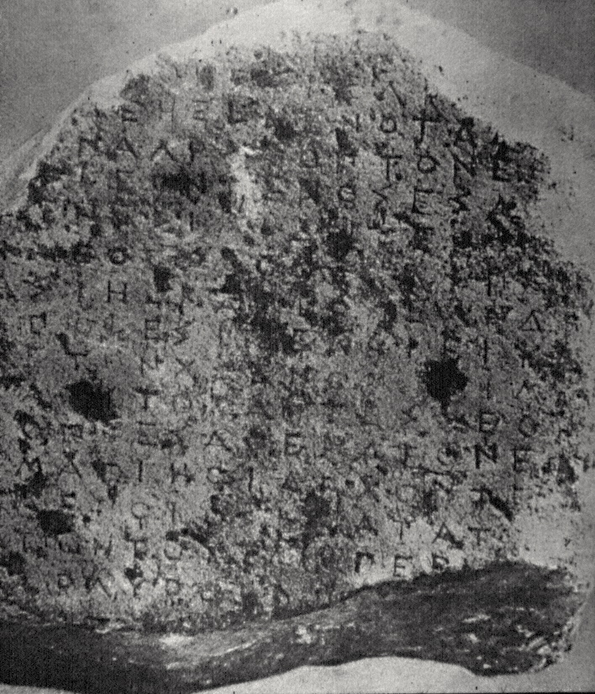
Case studies
IG I³ 1453 & ors – The Coinage Decree
Many examples all found outside Athens: Smyrna; Olbia (?); Aphytis (in Macedonia); Kos, Siphnos and Syme (islands); Hamaxitos (in the Troad)
No fragment has a date or datable reference
Numismatic evidence is no help
Kos fragment inscribed in Attic with the 3-bar sigma
Possible dates:
449 – ‘missing year’ on the ATL
414 - Aristophanes Birds 1040 ff parodies the decree
Mid 420s = consensus
Department of Ancient History

Slide 12
Case studies
IG I³ 1453 & ors – The Coinage Decree
Aphytis fragment is in two parts. The 1st fragment was published in 1935
The 2nd fragment was discovered in 1969 but “languished unrecognized” until publication in 2003 by Miltiades Hatzopoulos
The second fragment (non-joining) preserves the end of the stele
So what?
The Smyrna fragment contains the same final words as the Aphytis fragment, but its text continues for another 9 lines, with big discrepancies in content.
Major implications for epigraphical method. Cannot assume a ‘composite’ text. Different copies were set up tailored to local circumstances. Was there more than one date and/or more than one decree? (Per R. Stroud [2006], 18-26)
Department of Ancient History

Slide 13
Dating imperialism
The word ‘empire’ has pejorative connotations - changed over (modern) time
Inscriptions attest to democratic practice
Thucydides (1.95-9) – summarises substantive change from 478 – 467 from hēgemonia (popular leadership) to archē (exacting rule/control)
He portrays Athenian empire as moderate under Pericles, but harsh under Cleon and his fellow demagogues. Scholars tend to read the ‘tone’ of inscriptions through this prism
A down-dating (or redating back) of many of the inscriptions to 430s/420s fits this literary evidence better
Harris (2016) argues that paired opposites of demokratia/oligarchia enter discourse in the context of tensions with Sparta. Word demokratia 1st appears in the 420s – cf. Pericles’ funeral oration (Thuc. 2.37.1). Previously Athens based her right to lead on fighting the Persians and opposing tyranny.
Was there ever any intention to have an empire?
Department of Ancient History

Slide 14
Select Bibliography
J. Blok, ‘The priestess of Athena Nike: A new reading of IG I3 35 and 36’, Kernos [Online] 27 (2014).
M. H Chambers, R. Galluci, P. Spanos, ‘Athens’ Alliance with Egesta in the year of Antiphon’, ZPE 83 (1990), 38-57.
E. Harris, ‘The Flawed Origins of Greek Democracy’, in A. Havliček, C. Horn and J. Jinek (Eds.), Nous, Polis, Nomos (Academia Verlag 2016), 43-55.
* A. P. Matthaiou, R. Pitt (Eds.), Athinaion Episkopos: Studies in honour of Harold B. Mattingly (Athens 2014).
H. Mattingly, ‘The Athenian Coinage Decree’, Historia 10 (1961), 148-88.
H. Mattingly, The Athenian Empire Restored (Ann Arbor 1999).
* J. Ma, N. Papazarkadas, R. Parker (Eds.), Interpreting the Athenian Empire (Duckworth 2009).
P. Rhodes, ‘After the Three-Bar Sigma Controversy: The History of Athenian Imperialism Reassessed’, Classical Quarterly 58 (2008), 501-6.
R. Stroud, The Athenian Empire on Stone. David M. Lewis Memorial Lecture Oxford 2006. (Athens 2006).
Department of Ancient History
* Collection of articles, many of which are useful in this debate.

Slide 15
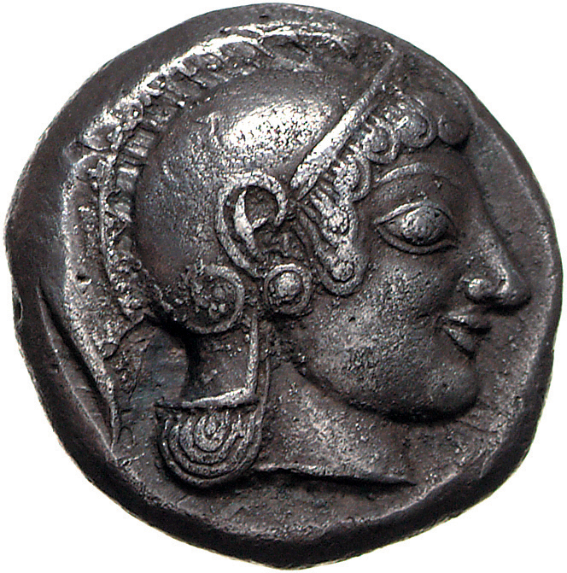
Thank you
Any questions?

